Slide 1

Telangana Tourism Analysis
By Sai Lakshmi

Slide 2
AGENDA
1
2
3
4
Objective
Data collection
Insights
Overview

Slide 3

The Objective
As a data analyst, the objective of the project would be to analyze the tourism data published by the Telangana government under its open data policy, identify patterns and insights, and provide data-informed recommendations to the government. The goal of this project would be to help the Telangana government improve their administrative operations and increase their tourism revenue.

Slide 4
Factors Influence Telangana
Cultural Heritage
Hospitality
Connectivity

Slide 5
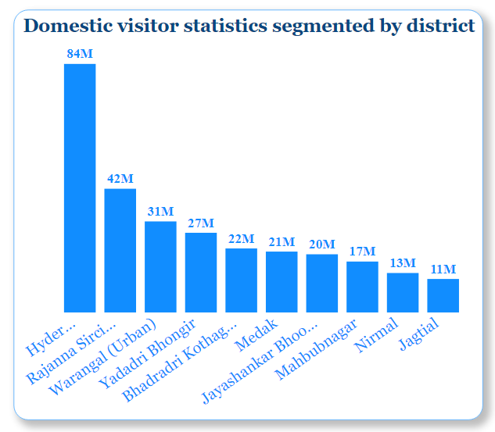
Question 1:
List down the top 10 districts that have the highest number of visitors overall (2016-2019)
Output:
Insight:
Hyderabad is the first place in Telangana to receive 84 million domestic visitors.The next most popular destinations for tourists are Rajanna Siricilla and Yadadri Bhongir in Warangal district

Slide 6
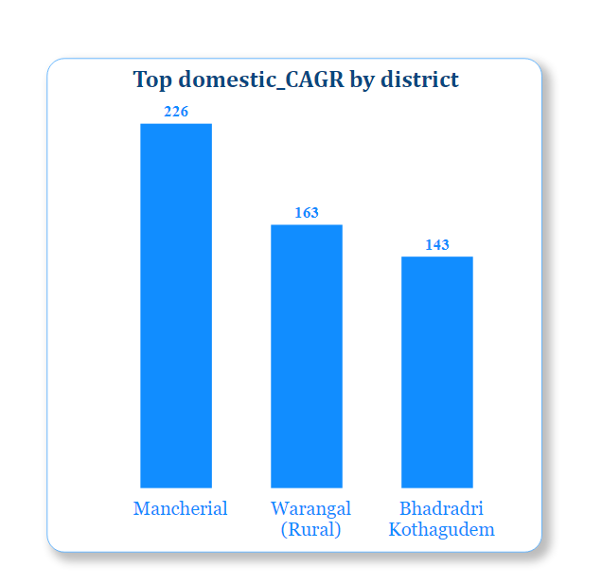
Question 2:
List down the top 3 districts based on compounded annual growth rate(CAGR) of visitors between (2016-2019)
Output:
Insight:
Mancherial,Warangal and Bhadradri Kothagudem are the top three cities in Telangana with the highest Compound Annual Growth Rate (CAGR) in terms of tourism.

Slide 7
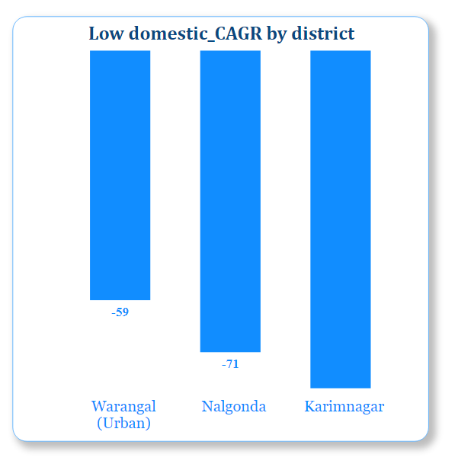
Question 3:
List down the bottom 3 districts based on compounded annual growth rate(CAGR) of visitors between (2016-2019)
Output:
Insight:
Warangal Urban, Nalgonda, and Karimnagar are the three districts in Telangana with a comparatively low Compound Annual Growth Rate (CAGR) in terms of tourism.

Slide 8
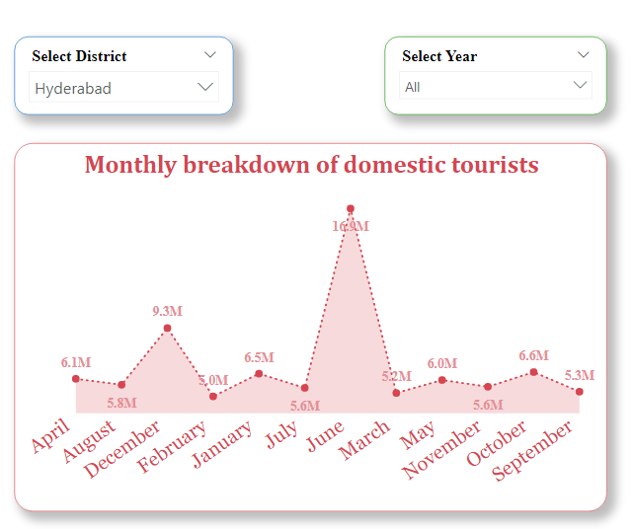
Question 4:
What are the peak months for Hyderabad based on the data from 2016 - 2019
Output:
Insight:
June and December are months that coincide with school holidays in many parts of India. This could be contributing to the higher number of domestic tourists in Hyderabad during these months, as families take advantage of the break to go on vacations and explore new destinations.

Slide 9
Question 5:
What are the low months for Hyderabad based on the data from 2016 - 2019
Output:
Insight:
February and March are the months with the lowest number of domestic tourists in Hyderabad.The reasons for the lower number of domestic tourists in Hyderabad during February and March could be a combination of factors such as weather, school and work commitments, fewer festivals and events, and reduced tourism promotion.

Slide 10
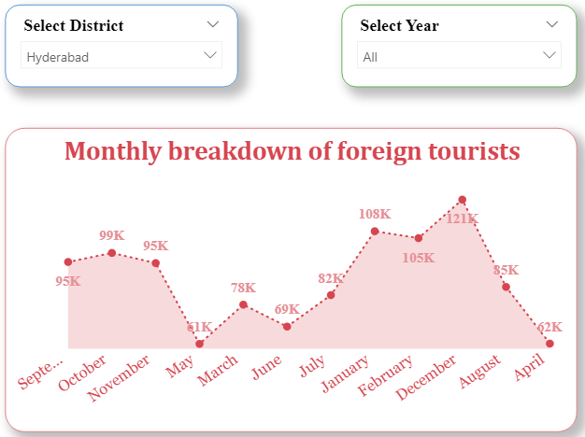
Question 4:
What are the peak months for Hyderabad based on the data from 2016 - 2019
Output:
Insight:
December and January are the peak months for foreign tourists in Telangana due to several reasons.
Firstly, the winter season in Telangana during these months offers a pleasant climate, making it an ideal time for tourists to visit the state.

Slide 11
Question 4:
What are the low months for Hyderabad based on the data from 2016 - 2019
Output:
Insight:
April and May are generally considered to be the low months for foreign tourist arrivals in Telangana.

Slide 12
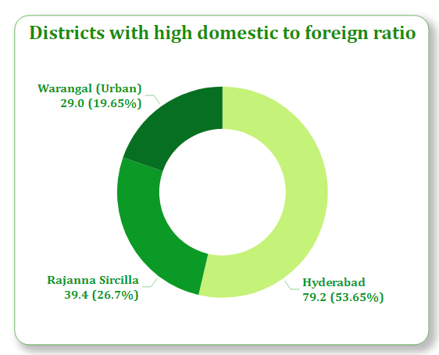
Question 6:
Show the top 3 districts with domestic to foreign tourist ratio
Insight:
Hyderabad has the highest domestic tourist ratio among all districts in Telangana, followed by Rajanna Siricilla and Warangal Urban.
Output:

Slide 13
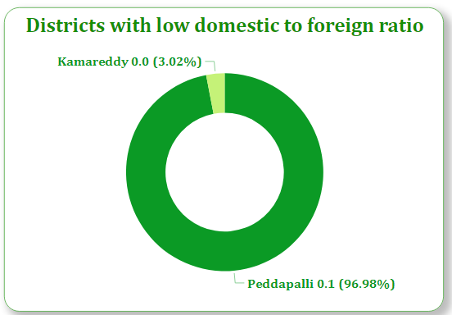
Question 7:
Show the bottom 3 districts with domestic to foreign tourist ratio
Output:
Insight:
Kamareddy, Peddapalli, and Medchal districts have a relatively low domestic to tourist ratio compared to other districts in Telangana.

Slide 14
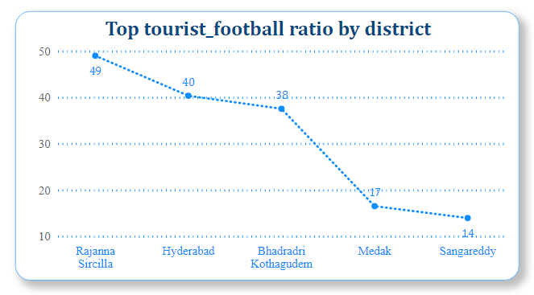
Question 8:
List the top 5 districts based on population to tourist football ratio in 2019
Output:
Insight:
RajannaSircilla,Hyderabad,andBhadradriKothagudemdistricts have a relatively high tourist footfall to population ratio compared to other districts in Telangana.

Slide 15
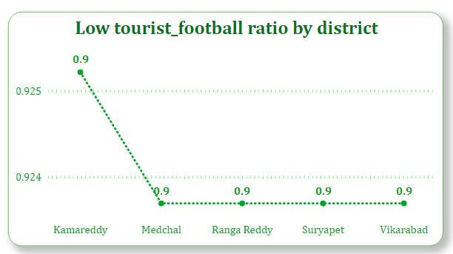
Question 9:
List the bottom 5 districts based on population to tourist football ratio in 2019
Insight:
Kamareddy, Peddapalli, and RangaReddy districts have a relatively low tourist football ratio compared to other districts in Telangana. The reasons for the low tourist football ratio could be a combination of factors such as lack of major tourist attractions, less developed tourism infrastructure, lack of promotion, and location
Output:

Slide 16
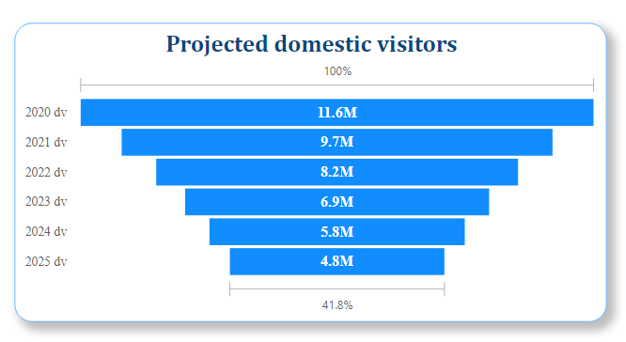
Question 10:
What will be the projected number of domestic tourist in Hyderabad in 2025 based on the growth are from previous years
Output:
Insight:
The projected number of domestic visitors to Telangana in 2025 is 4.8 million, which is significantly lower than the 12 million domestic visitors recorded in 2019. The COVID-19 pandemic has severely impacted the tourism industry, with many people choosing to avoid travel and stay home to prevent the spread of the virus

Slide 17
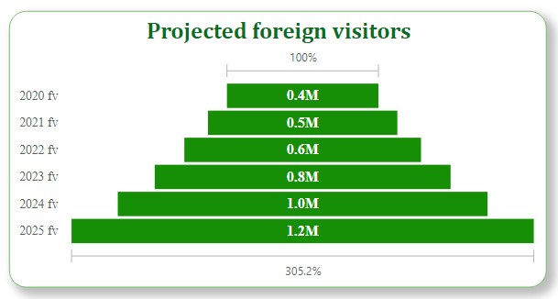
Question 11:
What will be the projected number of foreign tourist in Hyderabad in 2025 based on the growth are from previous years
Insight:
The number of foreign visitors to Telangana was 0.4 million in 2020, but the projected number of visitors in 2025 is 1.2 million.
Output:

Slide 18
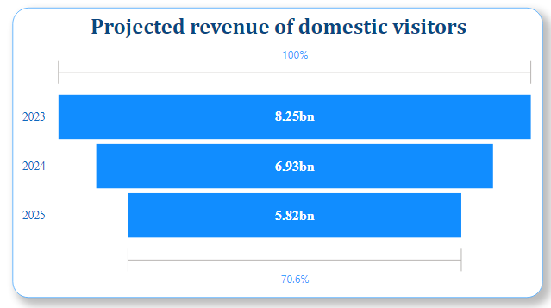
Question 12:
Estimate the projected revenue for Hyderabad in 2025 based on average spend per tourist
Output:
Insight:
The projected revenue of Telangana in 2023 is 8.25 billion.The projected revenue for 2025 is estimated to be 5.82 billion.

Slide 19
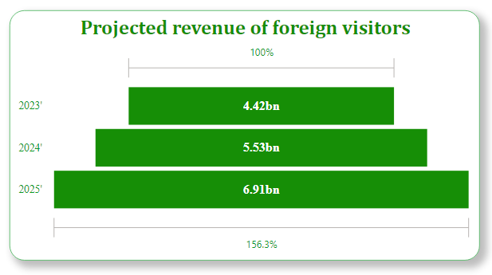
Question 13:
Estimate the projected revenue for Hyderabad in 2025 based on average spend per tourist
Output:
Insight:
The projected revenue of Telangana from foreign visitors in 2023 is 4.4 billion, and the revenue is expected to grow to 7 billion by 2025

Slide 20
Recommendations that can be provided to the government
Question:
Districts with highest potential
a.Which districts has the highest potential for tourism growth and what actions government can take
Telangana has several districts with untapped tourism potential, and the following three districts are some of the most promising:
Hyderabad: The government could focus on promoting lesser-known attractions, such as the Qutb Shahi Tombs or the Chowmahalla Palace. Additionally, investing in cultural festivals or events could also attract more visitors.
Warangal: Warangal has a rich history and several notable landmarks, including the Warangal Fort and the Thousand Pillar Temple. However, the district is still relatively unknown to many tourists. To boost tourism, the government could promote the district's unique cultural heritage, encourage the development of eco-tourism, and invest in the development of infrastructure and tourist amenities.
Adilabad: Adilabad is a district in northern Telangana that has immense potential for tourism growth. The district is home to several scenic locations, including the Kala Ashram and Kadam Dam. To promote tourism in Adilabad, the government could focus on developing adventure tourism, such as hiking or rock climbing, and invest in developing infrastructure for water sports and other recreational activities

Slide 21
Recommendations that can be provided to the government
Question:
Cultural/Corporate Events to boost tourism
a. What kind of events the government can conduct
b. Which months
c. Which districts
Cultural festivals showcasing the rich heritage of Telangana, such as the Bonalu festival, Bathukamma festival, Deccan festival, and Telangana food festival.
Corporate events like business conferences, trade shows, and exhibitions to promote Telangana as a hub for industries such as IT, pharma, and biotech.
Sports events like marathons, cricket tournaments, and adventure sports to attract sports enthusiast

Slide 22
b.The months for conducting these events can vary depending on the nature of the event. For example:
Cultural festivals like Bonalu and Bathukamma are usually celebrated in July-August and September-October respectively.
Corporate events can be held throughout the year, but some months like January, February, and March are popular for business conferences and trade shows.
Sports events can be held in the cooler months of November to February
c.The districts where these events can be conducted can vary based on the nature of the event and the target audience. For example:
Hyderabad, being the capital city and a major hub for industries, can host corporate events and sports events.
Warangal, Nizamabad, and Karimnagar are known for their cultural heritage, so cultural festivals can be held in these districts.
The districts of Adilabad, Khammam, and Mahabubnagar have several natural attractions like waterfalls and wildlife sanctuaries, making them ideal for adventure sports events.

Slide 23
Recommendations that can be provided to the government
Question:
Dubai has made itself a business hub and enjoys massive business tourism.Can Hyderabad emulate the dubai model
Hyderabad may not be able to fully replicate the Dubai model, there are several insights that can be drawn from Dubai's success that Hyderabad can adopt to attract more business tourism.
Infrastructure Development
Ease of Doing Business
Tourism Packages

Slide 24
Recommendations that can be provided to the government
Question:
Provide all other recommendations that can boost the Telangana tourism,particularly Hyderabad
Develop new tourist circuits
Improve connectivity
Leverage technology
Promote sustainable tourism
Enhance tourism infrastructure

Slide 25
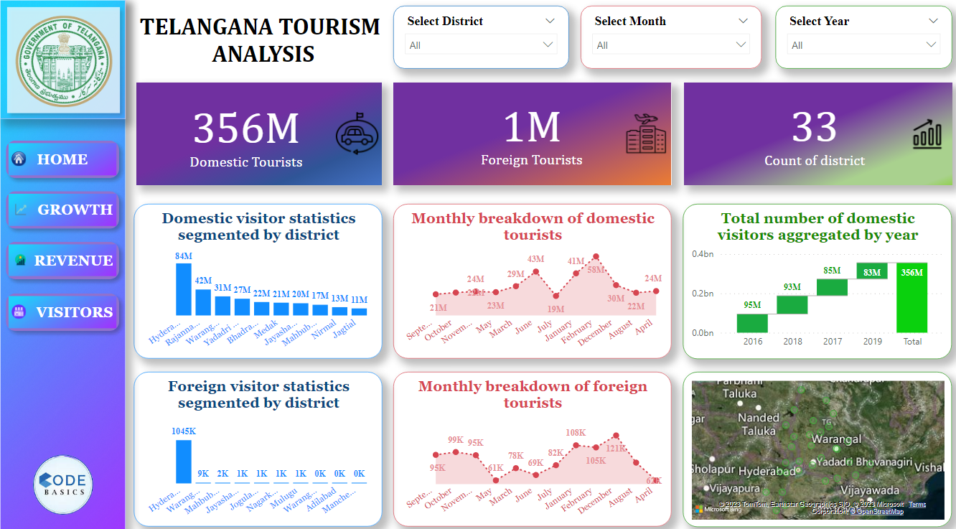

Slide 26
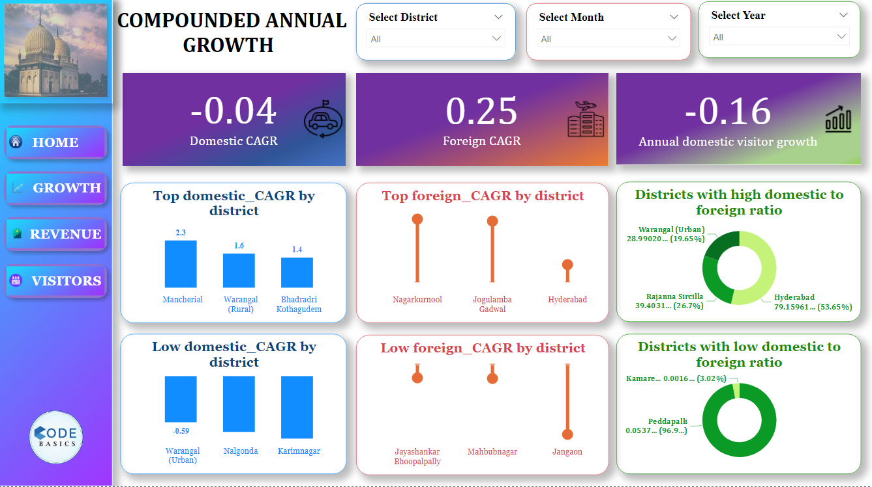

Slide 27
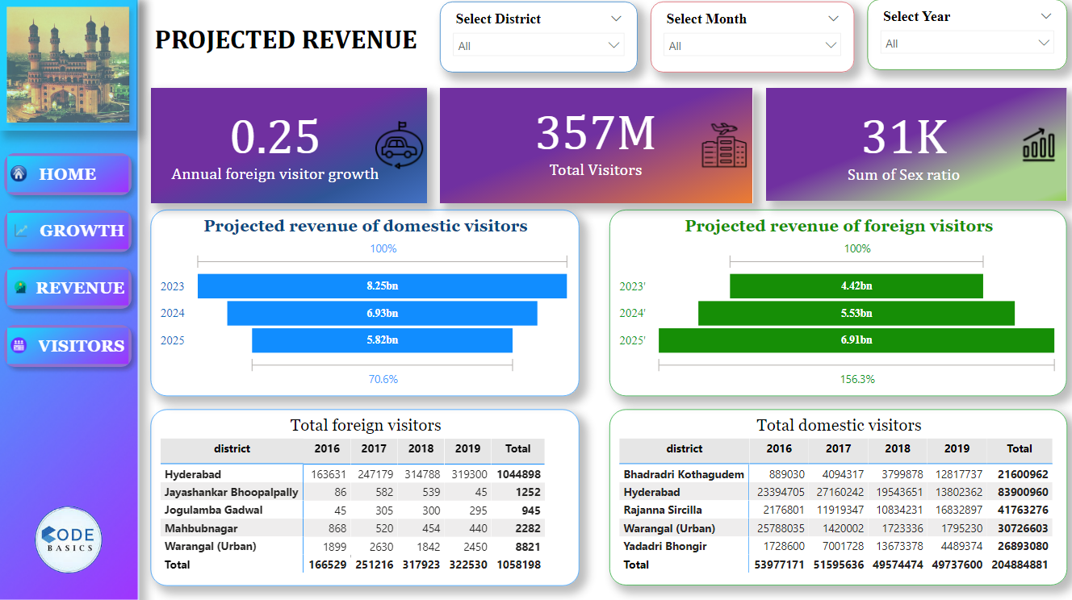

Slide 28
